Slide 1
Principles of Data Science
Li Niu

Slide 2


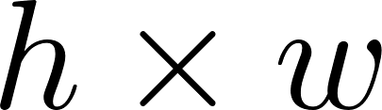


….
For a RGB image, the length of vector is 1,228,800

Slide 3

image
feature
extractor
The length of feature vector is 4,096

Slide 4


image
feature
extractor
….
frames
A 1-min video clip with 30 frames per second (fps) has 1800 frames.
If we concatenate the features of all frames, the total length is 7,372,800

Slide 5
video feature
extractor
frames
The length of feature vector may still be very high

Slide 6
Curse of dimensionality
“Curse of dimensionality” was first used by R. Bellman
in the introduction of his book “Dynamic programming” in 1957

Slide 7

Curse of dimensionality
Temporal and spatial complexity: storage cost and time cost

Slide 8
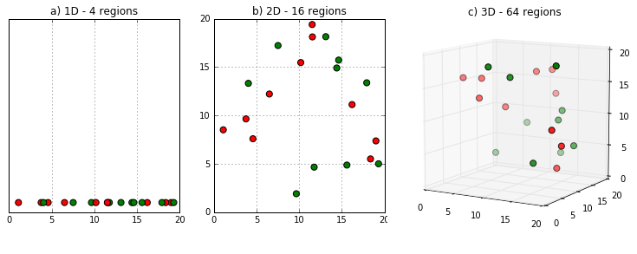
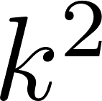
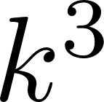
Curse of dimensionality
Require more training samples to fill in the space

Slide 9
Curse of dimensionality
From another perspective, feature dimension represents model complexity.
High model complexity, few training samples overfitting
Low model complexity, abundant training samples underfitting

Slide 10
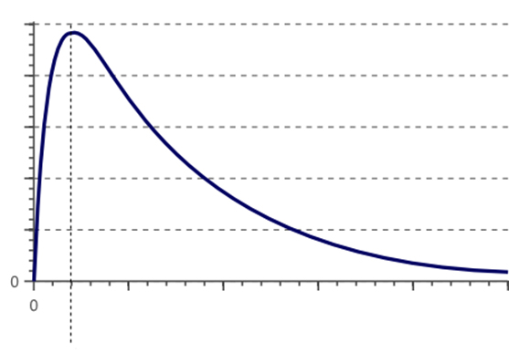
Curse of dimensionality
With fixed number of training samples, high dimension can easily cause overfitting.
Classifier performance
underfitting
overfitting
Feature dimension

Slide 11

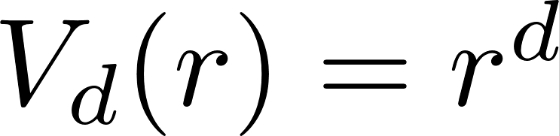
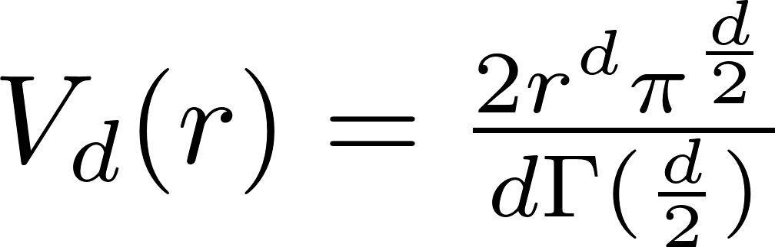


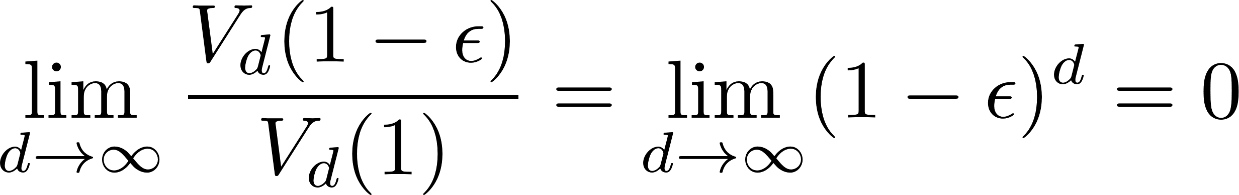
Curse of dimensionality
For a high-dimensional object, most of its volume is near the surface.
Given a d-dim volume, shrink this volume by a small amount
hypercube
hypersphere

Slide 12
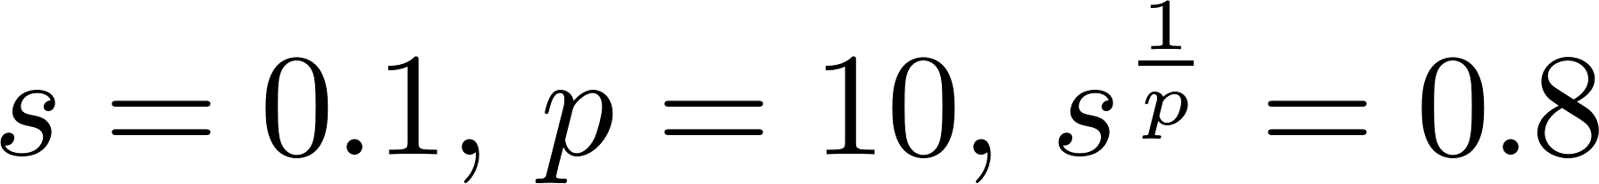
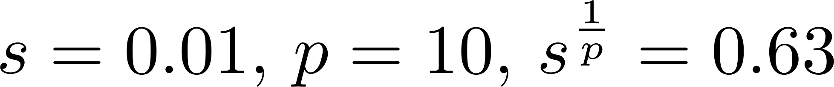
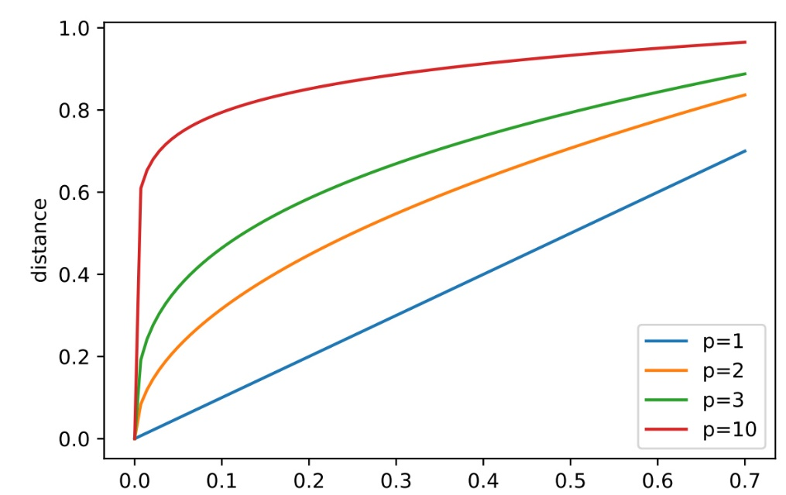
Curse of dimensionality
Given a p-dim hypercube, to capture a fraction s of the volume, you need the edge length to be:

Slide 13

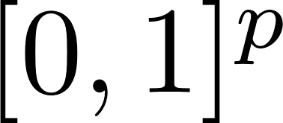
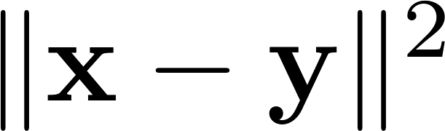
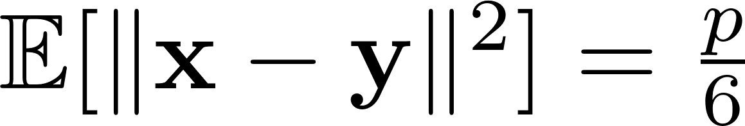
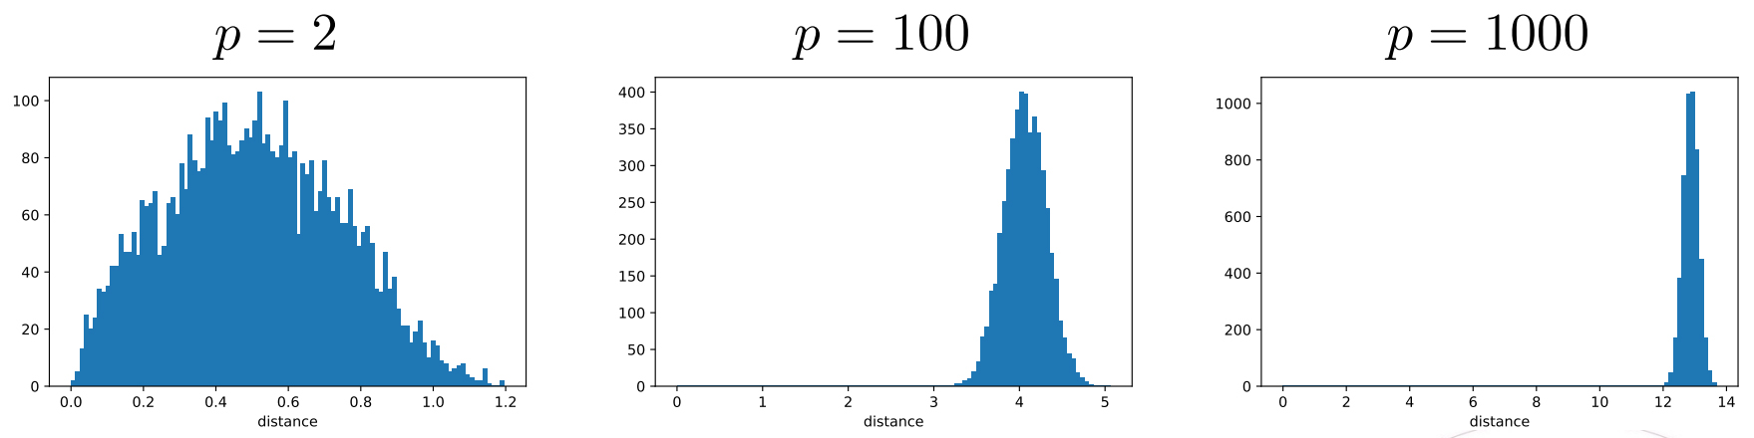
Curse of dimensionality
are two independent variables, with uniform distribution on .
The mean square distance satisfies
Histograms of pairwise-distances between n = 100 points sampled uniformly in the hypercube

Slide 14
Curse of dimensionality
Distances to near and to far neighbors become more and more similar with increasing dimensionality. Therefore, distance metric starts losing their effectiveness to measure dissimilarity in high-dim space.
Since classifiers depend on these distance metrics, it is more difficult to learn a good classifier.

Slide 15
How to avoid the curse of dimensionality?
Sample enough training data
Reduce feature dimensionality

Slide 16
Thanks!

